Slide 1
Major Federal Food Laws
John Khouryieh, PhD
Food Laws & Regulations
Western Kentucky University

Slide 2
Major Federal Food Laws
1. Federal Food, Drug, and Cosmetic Act (FD&C Act) of 1938
2. Federal Meat Inspection Act (FMIA) of 1906

Slide 3
1. Federal Food, Drug, and Cosmetic Act (FD&C Act) of 1938
Adopted to correct imperfections of the 1906 Act.
Gave FDA authority over cosmetics and medical devices as well as food and drugs.
The FD&C Act is the primary FOOD law in the U.S.

Slide 4
FD&C Act of 1938
Required pre-marketing approval and proof of the safety of drugs.
Extended government control to cosmetics and therapeutic devices.
Provided that safe tolerances be set for unavoidable poisonous substances in food.

Slide 5
FD&C Act of 1938 (cont’d)
Authorized standards of identity, quality, and fill-of-container for foods.
Authorized factory inspections.
Added court injunctions to the previous penalties of seizures and prosecutions.

Slide 6
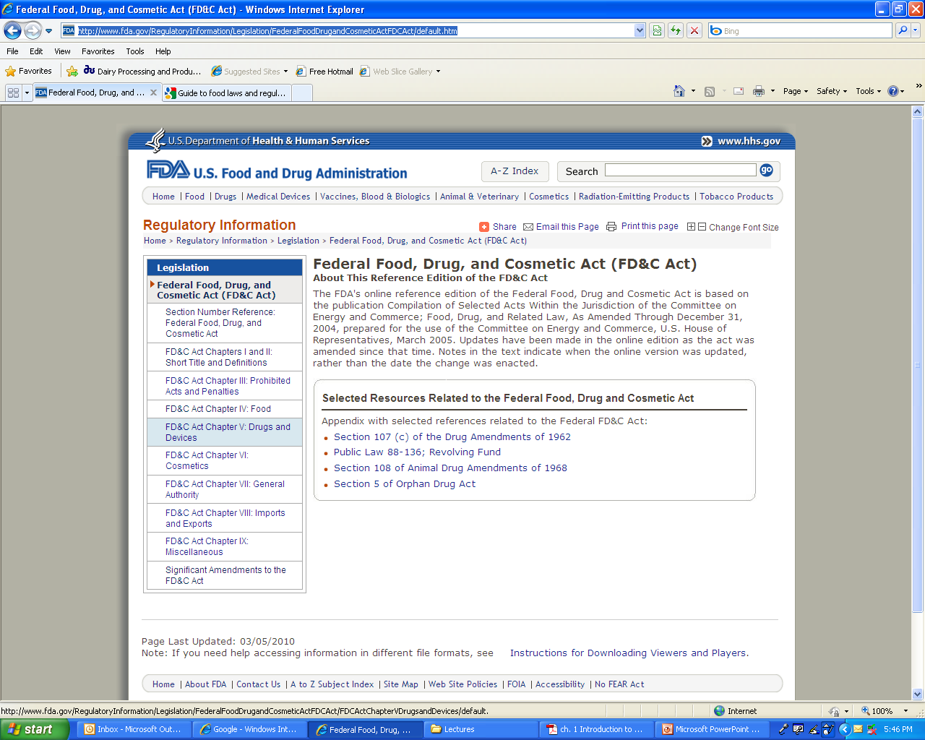
Federal Food, Drug, and Cosmetic Act Chapters

Slide 7
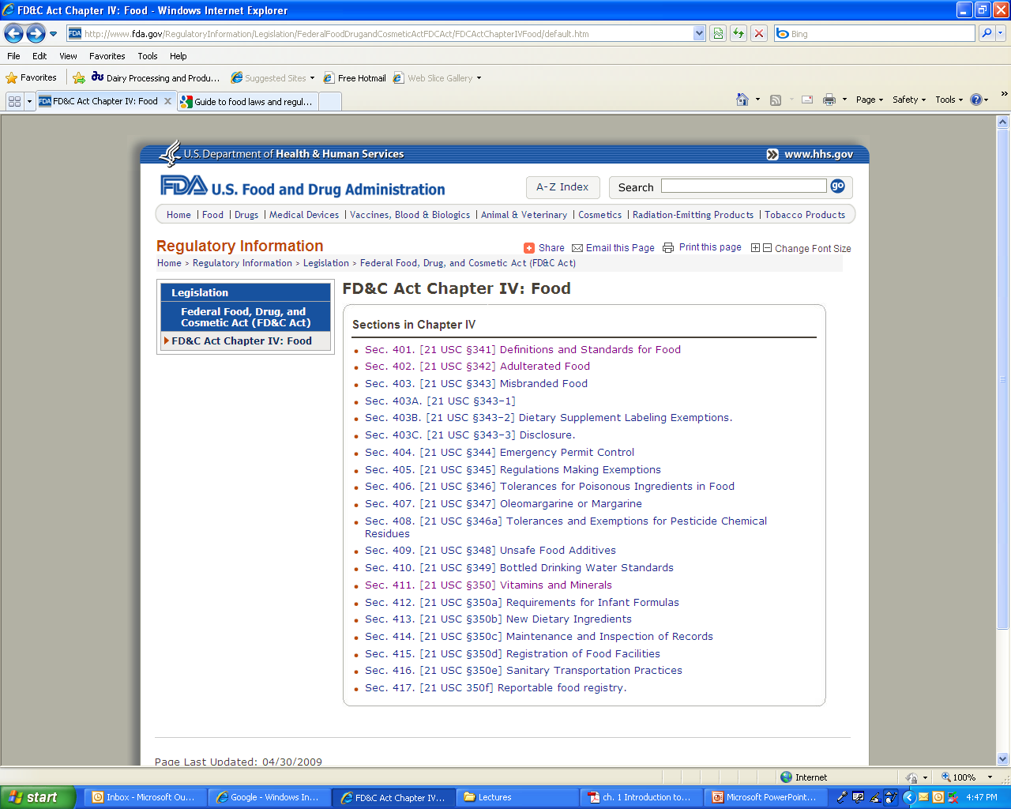
FD&C Act Chapter IV: Food

Slide 8
SOME SIGNIFICANT AMENDMENTS TO THE FD&C ACT
Food Additives Amendment of 1958
Food Color Amendment of 1960
Nutrition Labeling and Education Act of 1990
Dietary Supplement Health and Education Act of 1994
Food Quality Protection Act of 1996
Food Safety Modernization Act (FSMA) of 2011
http://www.fda.gov/RegulatoryInformation/Legislation/FederalFoodDrugandCosmeticActFDCAct/SignificantAmendmentstotheFDCAct/default.htm

Slide 9
Food Additives Amendment of 1958
Required the evaluation of food additives to establish safety.
Contained the Delaney Clause which prohibits the use of any substance in food that was found to cause cancer in laboratory animals.

Slide 10
Color Additive Amendment of 1960
Required manufacturers to establish the safety of color additives in foods, drugs, and cosmetics.
The Delaney Clause prohibited the approval of any color additive shown to induce cancer in humans or animals.

Slide 11
Fair Packaging and Labeling Act of 1966
Required all consumer products in interstate commerce to be honestly and informatively labeled, with FDA enforcing provisions on foods, drugs, cosmetics, and medical devices.

Slide 12
Low-Acid Food Processing Regulations
Issued by the FDA in 1973 after a number of outbreaks of botulism food poisoning from canned foods.
To ensure that low-acid foods have adequate heat treatment and are not hazardous.

Slide 13
Tamper-Resistant Packaging Regulations
Issued by the FDA in 1982 after deaths from cyanide placed in Tylenol capsules.

Slide 14
Federal Anti-Tampering Act
In 1983, Congress passed the Act , which makes it a federal crime to tamper with packaged consumer products.

Slide 15
Nutritional Labeling and Education Act (NLEA) of 1990
Required all packaged foods to bear nutrition labeling.
The law preempts state requirements about food standards, nutrition labeling, and health claims and, for the first time, authorizes some health claims for foods.
Standardized the food ingredient panel, serving sizes, and terms such as "low fat" and "light”.

Slide 16
Dietary Supplement Health and Education Act (DSHEA) of 1994
Established specific labeling requirements, provided a regulatory framework, and authorized FDA to promulgate good manufacturing practice regulations for dietary supplements.

Slide 17
DSHEA of 1994
Defined "dietary supplements" and "dietary ingredients" and classified them as food.
Established a commission to recommend how to regulate claims.

Slide 18
Food Quality Protection Act of 1996
Amended prior pesticide legislation
Mandated a single, health-based standard for all pesticides in all foods
Provided special protections for infants and children
Expedited approval of safer pesticides
Required periodic re-evaluation of pesticide registrations and tolerances

Slide 19
Food Allergy Labeling and Consumer Protection Act of 2004
Required the labeling of any food that contains a protein derived from any one of the following foods that account for the vast majority of food allergies:
peanuts, soybeans, cow's milk, eggs, fish, crustacean shellfish, tree nuts, and wheat.

Slide 20
Food Safety Modernization Act (FSMA) of 2011
The FSMA was signed into law by President Obama on January 4th, 2011.
It aims to ensure the U.S. food supply is safe by shifting the focus of federal regulators from responding to contamination to preventing it.

Slide 21
2. Federal Meat Inspection Act (FMIA) of 1906
Regulated by FSIS agency / USDA
The act was passed by Congress and signed by President Theodore Roosevelt to
Prevent adulterated livestock from being processed into food, and
Ensure that meat was slaughtered and processed under sanitary conditions.

Slide 22
SIGNIFICANT AMENDMENTS TO THE FEDERAL MEAT INSPECTION ACT
Poultry Products Inspection Act (PPIA) of 1957
Egg Products Inspection Act (EPIA) of 1970

Slide 23

Poultry Products Inspection Act (PPIA) of 1957
Congress passed the PPIA in 1957 in response to the rapidly expanding market for dressed, ready-to-cook poultry and processed poultry products.

Slide 24
Poultry Products Inspection Act (PPIA) of 1957 (Cont’d)
The act gives the authority to the FSIS to:
Provide inspection for all poultry products sold in interstate commerce, and
Reinspect imported products to ensure that they meet U.S. food safety standards.

Slide 25
Egg Products Inspection Act (EPIA) of 1970
Gives the authority to the FSIS to inspect egg products sold in interstate commerce, and reinspect imported products to ensure that they meet U.S. food safety standards.
In egg processing plants, inspection involves examining, before and after breaking, eggs intended for further processing and use as food.

Slide 26
Useful Websites
Significant Dates in U.S. Food and Drug Law History

